Slide 1
Pipeline Intro
Ziquan Wei

Slide 2
Raw data | Tool | Key Step | Output data (bolds are what we need)
T1w MRI (for structural) (X, Y, Z) | Freesurfer: recon-all | Skull strip Reg: (atlas -> image) Surface | Image Atlas segmentation mask (Aseg) Segmentation surface
DWI (for structural) (R, T, X, Y, Z) | FSL: bet | Skull strip | Images Brain mask
fMRI (for functional) (T, X, Y, Z) | fMRIprep | Skull strip Reg: (time 1~T -> time 0) Reg: (T1w -> time 0) Deform: (aseg -> images) Surface | Images Images Deformations Atlas segmentation mask (Aseg) Segmentation surface
T1w raw data
DWI raw data
DWI skull stripped brain mask
T1w surface (white mater)
Atlas (Parcellation)
CONTINUITY (python)
Adjacent matrix
https://github.com/Chrisa142857/CONTINUITY_v1.1

Slide 3
Atlas format convert
Convert any atlas to the format Freesurfer accepted.
Some atlas formats are Volume
NifTi or DICOM: "mri_convert" utility provided by Freesurfer.
e.g., Multi-Atlas Transfer Tools for Neuroimaging (maTT):
https://github.com/faskowit/multiAtlasTT

Slide 4
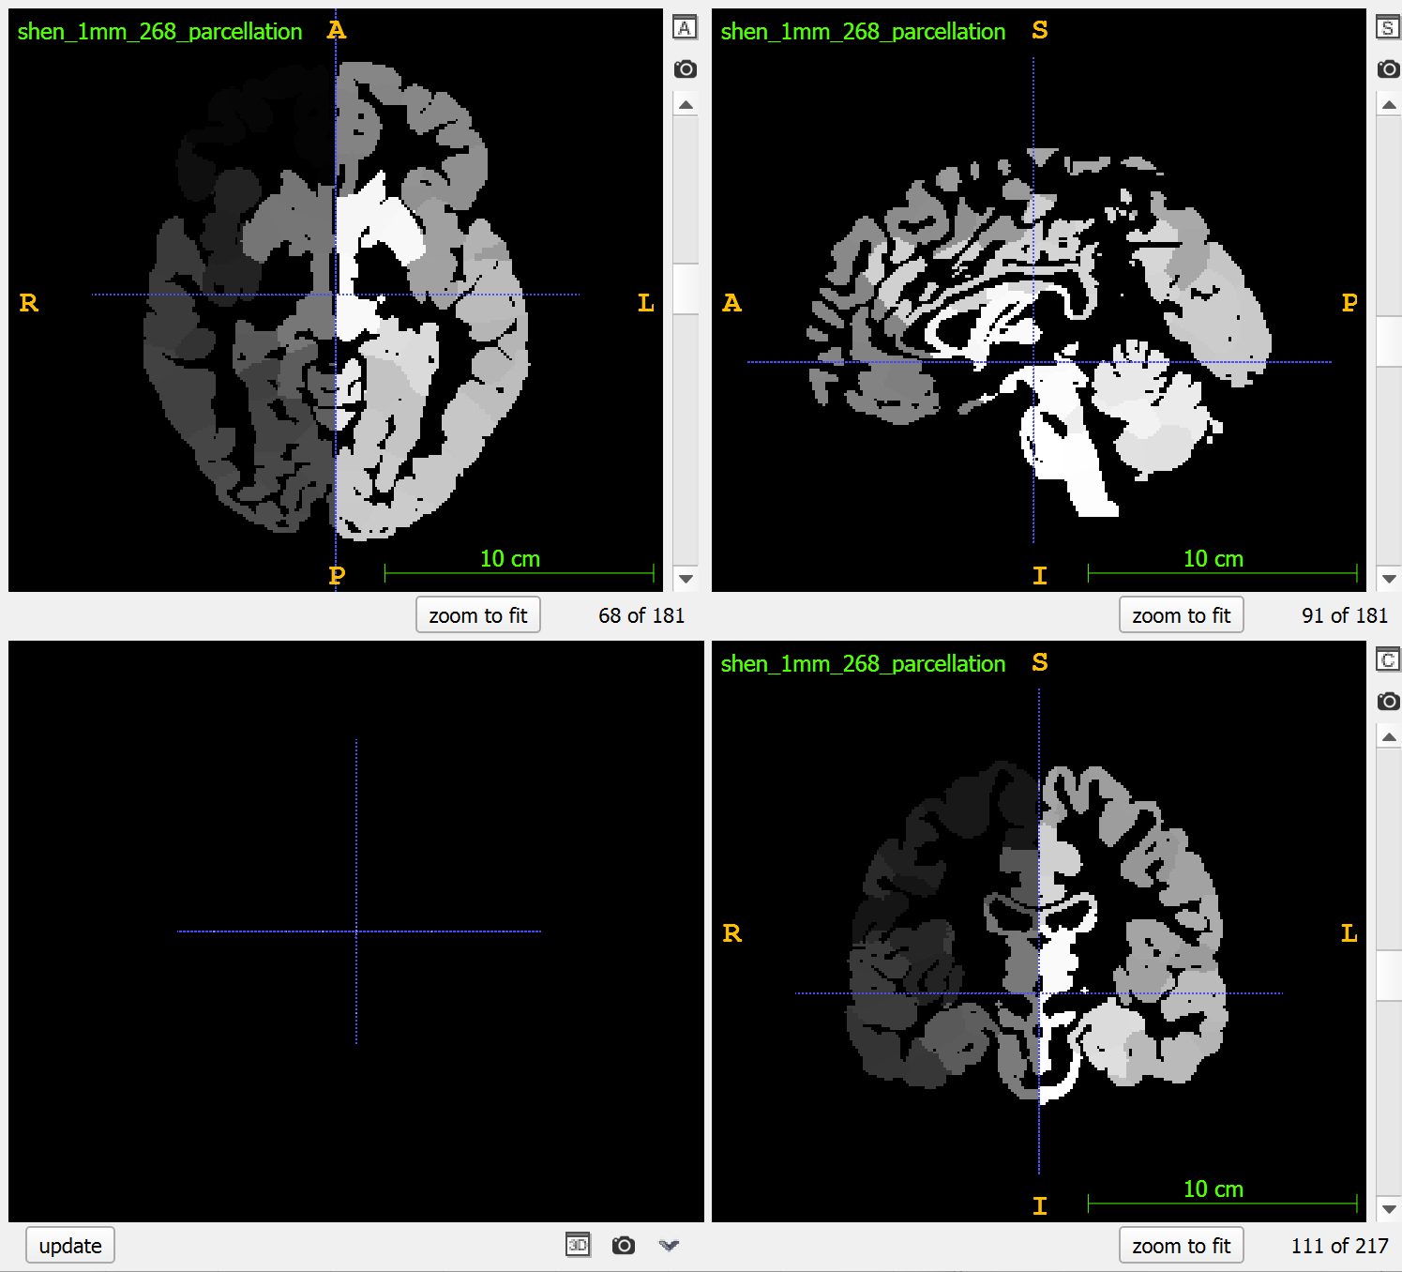
Volume atlas example
Atlas can be found in internet, for example:
https://www.lead-dbs.org/helpsupport/knowledge-base/atlasesresources/cortical-atlas-parcellations-mni-space/
https://github.com/faskowit/multiAtlasTT/tree/master/atlas_data

Slide 5
TODO list
What file format and data structure of the atlas are used by Freesurfer, fMRIprep.
Find a way to transfer any existing volume atlas to above formats.
Build the pipeline as a command-line tool
It can easily change atlas to produce new data
Each key step can be run by a single command
It can be used by high school students or freshman or non-CS people.

